Slide 1
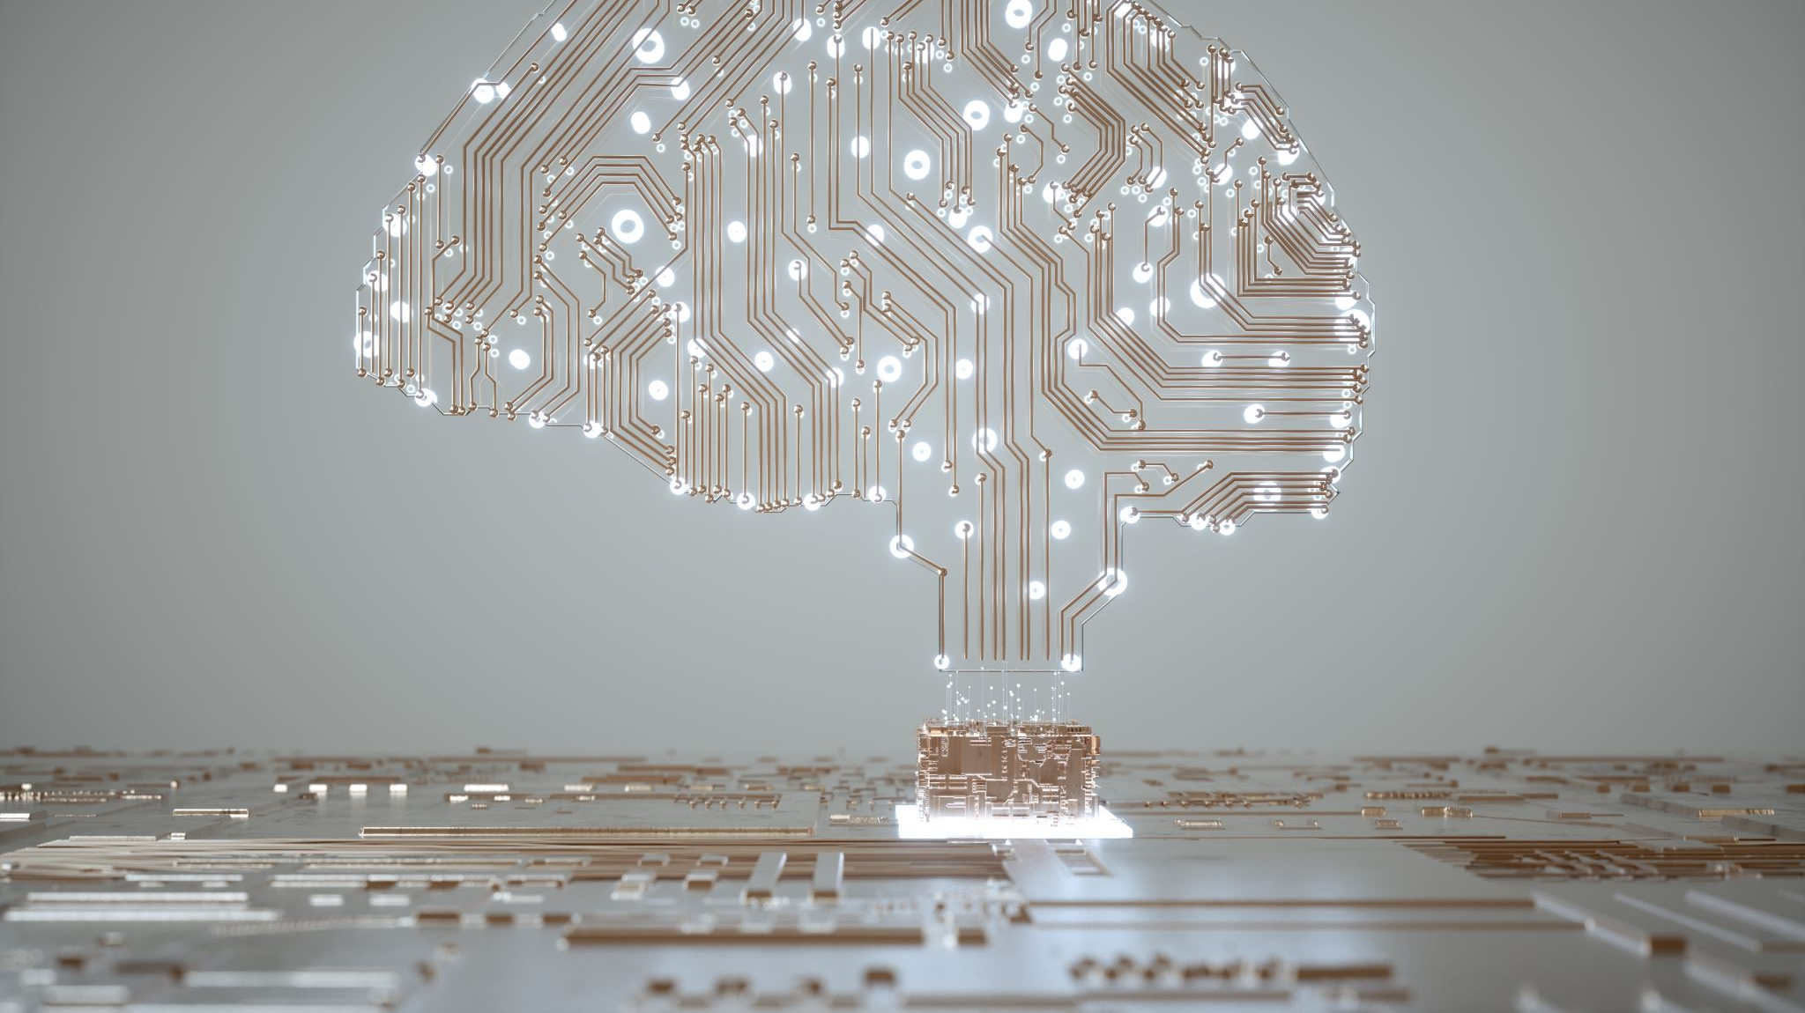
AI Business Education
Lubar Business School

Slide 2
Curriculum
Introduction to AI
History of AI
Types of AI
Decision of AI (What to use and When)
Cognitive AI
Machine/Deep/Reinforcement Learning – AML Services

Slide 3
Types of AI
Cognitive – Pre Built
ML/DL/RL – Custom Build from Scratch

Slide 4
Decision Tree

Slide 5
AI Business school
Conversation AI
AI Services
Knowledge Mining
Autonomous Systems
Responsible AI
Link

Slide 6

AI Services
Cognitive Services – link
Data Science Program/Project Management – TDSP
Trainer training link
AI Business school link
Cognitive Services – create
Responsible AI for business link

Slide 7
AI Services
Custom Vision link
AI Services Link
Form and Object extraction link
Intro to Translator link
Speech to text link
Speech processing – link
Metric advisor link
Azure ML SDK link
Automated ML link

Slide 8
Shape you career of future tech
What is AI?
Human based automation – Enable AI to automate process or tasks.
What tools are used in AI
Cognitive AI
NLP, Vision/OCR, Text Analytics, Speech/Translation, Personalization – Faster to Market – Developer centric – Time to Value is fast
ML/DL/RL
Custom Modelling, IP with your own data
Tabular, Image, Video, Audio, NoSQL
Day in life of AI career
Increase Productivity with your design
Build Intelligence into your design
What is the Personal value driven by AI
Intelligent skills
Driven by future

Slide 9

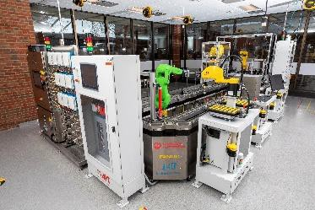
Microsoft Azure for Manufacturing Excellence (AME)
Objectives:
Expected Outcomes:
Develop learning pathways levering Microsoft training tools and certifications oriented to specific job titles.
Generate attention to value of CSI programming to Federal, State and Local funding agencies.
Data Engineer
Fundamentals Data Fundamentals
Designing a Data Solution
Implementing Data Solutions
Azure AI Engineer
Fundamentals AI Fundamentals
Designing & Implementing AI
Initiate drive to campaigns to identify student candidates
Attract direct funding for displaced workers to sponsor their tuition.
Matchmake student candidates with mentors from industry and CSI.
Azure IOT Developer
Fundamentals Data Fundamentals IOT Developer
Azure Data Scientist Associate
Fundamentals AI Fundamentals
Designing & Implementing a
Data Science Solution
Increase the number of students and employers interacting through CSI.
Market graduate credentials to identify tuition funding and sponsorship.
Learners graduating from these pathways earn Microsoft Credentials certifying KSA’s Microsoft base curriculum is delivered with hands on experience in CSI Labs
Special focus on use cases relevant to the manufacturing environment.
Notes:
CDO wants to setup a centralized organization to manage and create data assets-based business for future. This also emphasis on Self service BI, Data driven Decision making and Advanced analytics like Machine learning or Artificial Intelligence
Self service BI
Data Driven decision making
Machine learning/AI based Insights
Data asset-based revenue – internal and external
Becoming True intelligent organization
CDO – Chief Digital or Data Officer
CAO – Chief Analytics Officer

